Slide 1
MT Geospatial Information Advisory Council Meeting
GIS Coordinator’s Report
Erin Fashoway, Montana GIS Coordinator
9/12/2024

Slide 2
GIS Coordinator’s Report

Slide 3
Outreach Activities
Esri Annual User Conference
Montana Clerk & Records / Election Administrators
MT Association of Counties
MT 9-1-1 Fall Conference (APCO/NENA)
National States Geographic Information Council Annual Conference (NSGIC)
MARLS Fall Meeting (?)
MT League of Cities & Towns
MT Association of Planners (MAP)
American Water Resources Association (AWRA)
Natural Heritage Program Partners Meeting
State Planning Meeting – Supports Esri Enterprise Agreement Contract Work

Slide 4
Esri Enterprise Agreement &
Master Purchase Agreement Negotiations
Esri EA
  Negotiations in progress
Master Purchase Agreement
  Negotiations in progress
  Several iterations back and for the between Esri & SITSD
    Please direct questions to Erin Fashoway and we will put you in contact with proper contacts at State ITSD

Slide 5
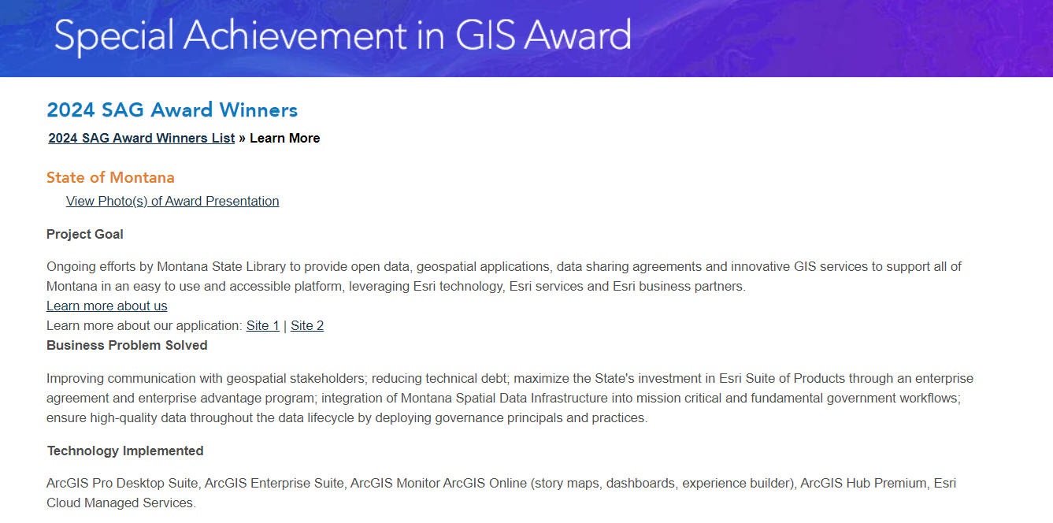
Special Achievement in GIS Award
Esri presented the Montana State Library a SAG Award at the 2024 Esri International Users Conference
https://events.esri.com/conference/sagList/?fa=Detail&SID=7794

Slide 6
Thank you!

