Slide 1
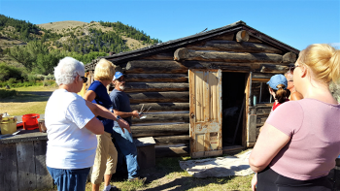
Who we are & What we do:
501(c)(3) nonprofit organization
We raise money and make grants for preservation and heritage projects
We have placed $1.5M in community-based history projects from Libby to Ekalaka since 2012.
Thanks to you Arpa funds went to:
Make grants to 9 projects in 8 communities
Digitize historical documents & photographs
Record, transcribe, and/or digitize 6 oral history projects
Capture and record video reminiscences
Create a podcast with international artists
The foundation re-granted $57,122
All projects uploaded to the Montana History portal

Slide 2
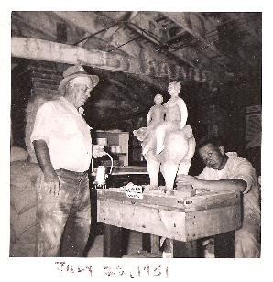
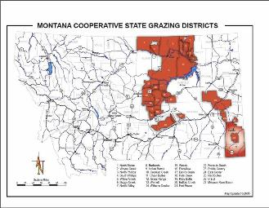
The Montana Association of State Grazing Districts received a grant of $10,000 to digitize over 500 pages of their historical records
The Archie Bray Foundation in Helena received a grant of $10,000 to record 15 interviews with innternational artists for the podcast” Beyond the Brickyard”
Staff at the O’Fallon Historical Museum used a grant for $3,447 to conduct oral histories with elders in Baker

Slide 3
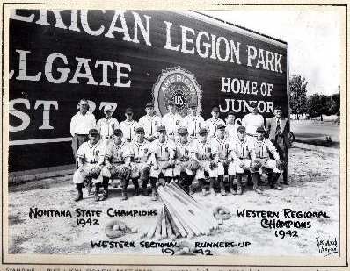
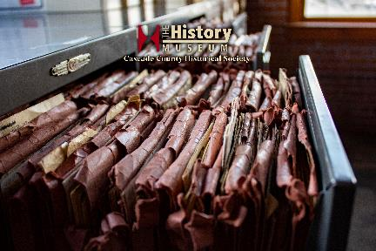
The Bear Paw Development Corp.in Chinook received a grant of $8,400to record interviews with descendant of the Metis settlers of the Hi-Line
Legion Hellgate Post No. 27 recorded 10 oral interviews with former members of the Missoula Mavericks baseball club documenting 100 years of Mavericks baseball.
The Cascade Co Historical Society in Great Falls used a grant of $7,440 to record and transcribe 12 interviews documenting stories and voices of north-central Montana

Slide 4
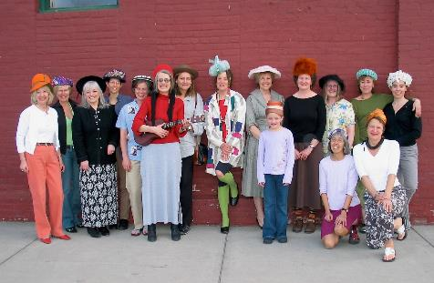
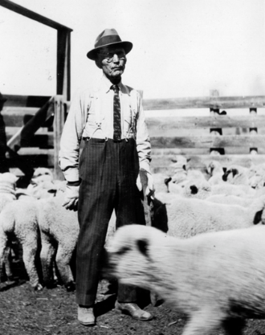
The Montana Museum of Art & Culture used $6,000 to conduct 19 oral histories with artist members of the Pattee Canyon Ladies Salon
Helena Civic Television received grant of $10,000 to capture recollections of the 1972 delegates to Montana’s Constitutional Convention
A grant for $1,000 allowed for the transcription and digitization of 9 oral histories of Montanans who remembered working with pioneer Henry Sieben

