Slide 1
Integration of MSDI Address GIS Point Data into 9-1-1 and Elections Workflows
Erin Fashoway

Slide 2
Outline
Brief Overview & History of the Structures & Addresses MSDI Framework
Structures & Addresses MSDI Framework use in Next Generation 9-1-1
Partnership with the Secretary of State’s Office and County Election Administrators
Geo-enabled Elections Efforts
Notes:
About MSL – MSL is the state agency responsible for statewide GIS coordination, maintaining statewide GIS layers ("Montana Spatial Data Infrastructure", MSDI)
Two of those MSDI layers – Administrative Boundaries and Structures/Addresses are critical to integrating GIS into elections management
MSL is working closely with county governments and the SOS to create statewide data layers to support the new election management system, which includes a GIS and mapping component
The focus today is on addresses, but be aware that MSL is also doing a lot of work to support developing the needed GIS boundary datasets

Slide 3
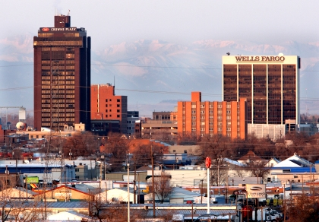
MSDI Structures & Addresses Framework
The Structures and Addresses Framework is a routinely-updated statewide spatial database of primary structures, buildings and their addresses. The geodatabase consists of a point feature class and related metadata tables. Both structure and address points are contained in the point feature class, along with all their associated attribute information.

Slide 4
History of the MSDI Structures & Addresses Framework
2005 - 2009
2009 - 2010
2011
2012
2015 - present
Office of Domestic Preparedness issued grants for collection of critical infrastructure. First data model critical infrastructure created.
Focus on collecting non-sensitive structure data statewide. Some addressing data being collected
Started focus on collecting Address data
Awareness & Compliance with NG9-1-1
Actively working toward data NG9-1-1 Compliance

Slide 5
Structures & Addresses MSDI Framework use in Next Generation 9-1-1
In most counties, GIS address points were created for E9-1-1
NG9-1-1 increases the reliance on GIS address points
Newer NG9-1-1 GIS data standards, developed by the National Emergency Number Association (NENA) and adopted in Montana's Statewide 9-1-1 Plan, recognize the utility of GIS address points for uses beyond 9-1-1
Notes:
Enhanced 9-1-1 – GIS used just for the map to help visualize where calls are from – no geospatial analysis
Next Generation 9-1-1 – GIS data will be used as a 9-1-1 call is made to route the call to the correct Public Safety Answering Point (PSAP), or 9-1-1 call center – point in polygon analysis is completed before dispatch answers the call
Uses beyond 9-1-1 – elections, broadband mapping, etc.
For example, one way the NENA standards other uses is including Postal community and ZIP Code fields in the NENA NG9-1-1 GIS Data Model Standard
Improve data quality – ex: voter addresses are a subset of all the addresses out there, but they can be used as a QC of the larger, 9-1-1 address dataset

Slide 6
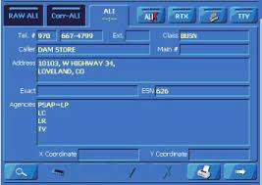
BEFORE CELL PHONES
E9-1-1 - Phone tied to Address
1001 Park Lane
406-499-1234
406-499-1234 1001 Park Lane
This is a simplification of the process

Slide 7
End Goal: NG9-1-1 – With the Use of Cell Phones
1001 Park Lane
1050 Park Lane
This is a simplification of the process
Notes:
Addresses are needed for land lines phones and for dispatchable addresses.

Slide 8
One Address Dataset for All
Goal – use a single, authoritative address point dataset for 9-1-1, elections, navigation, package delivery, etc.
Leveraging a single address point dataset for other uses, including voter addressing, increases the return on investment and helps improve data quality
Coordination of Address Data at Local Level
Election Administrators (EA) will coordinate with their local addressing authority (GIS, 9-1-1, etc.) to ensure new voter addresses are in the GIS data, and correct discrepancies with existing voter addresses
Notes:
Enhanced 9-1-1 – GIS used just for the map to help visualize where calls are from – no geospatial analysis
Next Generation 9-1-1 – GIS data will be used as a 9-1-1 call is made to route the call to the correct Public Safety Answering Point (PSAP), or 9-1-1 call center – point in polygon analysis is completed before dispatch answers the call
Uses beyond 9-1-1 – elections, broadband mapping, etc.
For example, one way the NENA standards other uses is including Postal community and ZIP Code fields in the NENA NG9-1-1 GIS Data Model Standard
Improve data quality – ex: voter addresses are a subset of all the addresses out there, but they can be used as a QC of the larger, 9-1-1 address dataset

Slide 9
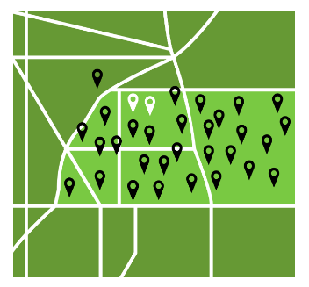
Address Data for NG9-1-1 & Elections
Parallels between NG9-1-1 and integrating GIS into elections: tabular systems moving to GIS
Need an Address point for every
9-1-1 dispatchable address
Voter address
Complete statewide address data
Standardized address data that represents the official address assigned by the local government
Address points located at the structure
Notes:
9-1-1 and elections traditionally both relied on tabular address files that were manually associated with a boundary (precinct split / PSAP boundary)
NG9-1-1 and this new elections effort are both moving from relying on tabular data to using GIS data (address points and boundaries)
Advantages: more accurately locate voter’s address, automate assigning of districts and splits for elections, and reduce possibility for errors. This will assist with upholding the integrity of Montana elections
Standardized data – for elections purposes, this means to USPS standards (abbreviated street types and pre/post directionals)
Moving addresses to structure – some counties at driveway/access, but the trend is to moving to the more accurate structure location and this benefits both 9-1-1 as well as meets requirements for elections, broadband mapping…

Slide 10
Partnership with the Secretary of State’s Office and County Election Administrators
2018: NSGIC – National Geo-Enabled Election (GEE) Project Began – Montana on Steering Group
2019 – 2021:
Started Partnership with Montana Secretary of State’s Office
Montana Participated in 2 rounds of NSGIC’s GEE Pilot Project for Geo-enabling Elections
2021:
Official Agreement with SOS to partner on Geo-enabling Elections
Hired GIS Specialist
2022:
Compiling statewide elections boundaries
Geocoding voter addresses

Slide 11
Benefits to Elections Management
Geo-enabled Elections has shown efficiencies in elections management workflows
Geospatial awareness of voters
Ease of registering new voters
Increased confidence that voters receive the correct ballot
Post redistricting: Help assigning voters to new precincts
Reduce manual workflows – save time & money

Slide 12
Questions
Erin Fashoway
efashoway@mt.gov
406-444-9013

