Slide 1
Personal Planning for Professional Development
Elizabeth D. Woodard
Norfolk Public Library
Training and Technology Administrator
November 2020
Notes:
Good afternoon.
Thank you all for joining me today and thank you to the Montana State Library and especially to Joann for providing this connection for us. …….
In all of my responsibilities for work; in the retail industry as a manager and a business owner, in school libraries and in public libraries I have been r
Training is important in any job but especially in libraries because libraries are always moving on the cutting edge of transformations. Libraries react endlessly to technology changes, social needs, community interests, political climates and (as we have recently discovered) local, national and global crises. I believe that training is the tool to prepare for change and more informed decision making. Training allows us to maneuver what we need for optimal practices and helps us manage the constant uncertainty of our work and lives. Currently the world and libraries are dealing with new topics of concern; sustainability in a pandemic, community assistance with social injustice, the census, voting, climate change, school closings, unemployment and the reality of teleworking. How are these concerns affecting libraries and your work? Whether you are learning something new, re-learning something old, or un-learning bad habits or archaic processes, professional development is personal and needs to meet your current needs. I have been responsible for the training or teaching of others and I have come to believe that Success Happens when yOUr Learning is Designed for it.

Slide 2
Intentional Decision Making
Purpose
Outcomes
Policies, procedures, remediation, and pathway
Mandated or Required for Certification
New perspectives, attitudes, resources, update skills, learn new strategies
Goal Oriented
Advancement, promotion and performance evaluations
Notes:
Today we want to delve into making a conscious decision to make personal plans for your Professional Development.
Let’s start by looking at the purpose for training and consider the various outcomes.
I have read the Montana Personal Professional Development Plan Pathway Manual and understand that some of your training may be needed because your organization has provided a program specific to the direction of certification. In this case your training may be part of the certification program or recertification needs. Other mandated training may include a new policy, process or technology. Your training may be to answer a need for remediation or simply a reminder or focus on something important. You should take on mandatory training with VIGOR as it will provide a window into the perspective of your organization’s leadership (what do they want from you or your department, what is their focus, etc) and, at the very least it will affirm your belief, your loyalty, and your dedication to the organization as you partake in continual mandated training with an ‘I need to know’ attitude. Often times we don’t know what we don’t know and this may be the training that will shed light on the obscure of dysfunctional.
You should set up professional goals for yourself and make an intentional decision to seek training that helps you reach those goals. I will talk about creating those professional goals and matching those with professional development needs but let’s first finish the conversation about why you take professional development and what are the outcomes from your training. If you can participate in training that is goal-oriented, not just mandated, you may be filling a need for learning new resources, creating a new attitude or seeing varied perspectives from others. Goal-oriented training might answer the need to update skills, add new technologies, learn a new strategy for the same work or discover changed paradigms. Or you may be seeking new tools in order to reach an advanced level in your performance or meet new requirements for a higher position.
Regardless the impetus, mandated or goal-oriented, the outcome is about improving your value to the organization, improving your performance and increasing or maintaining your own satisfaction with your work.

Slide 3
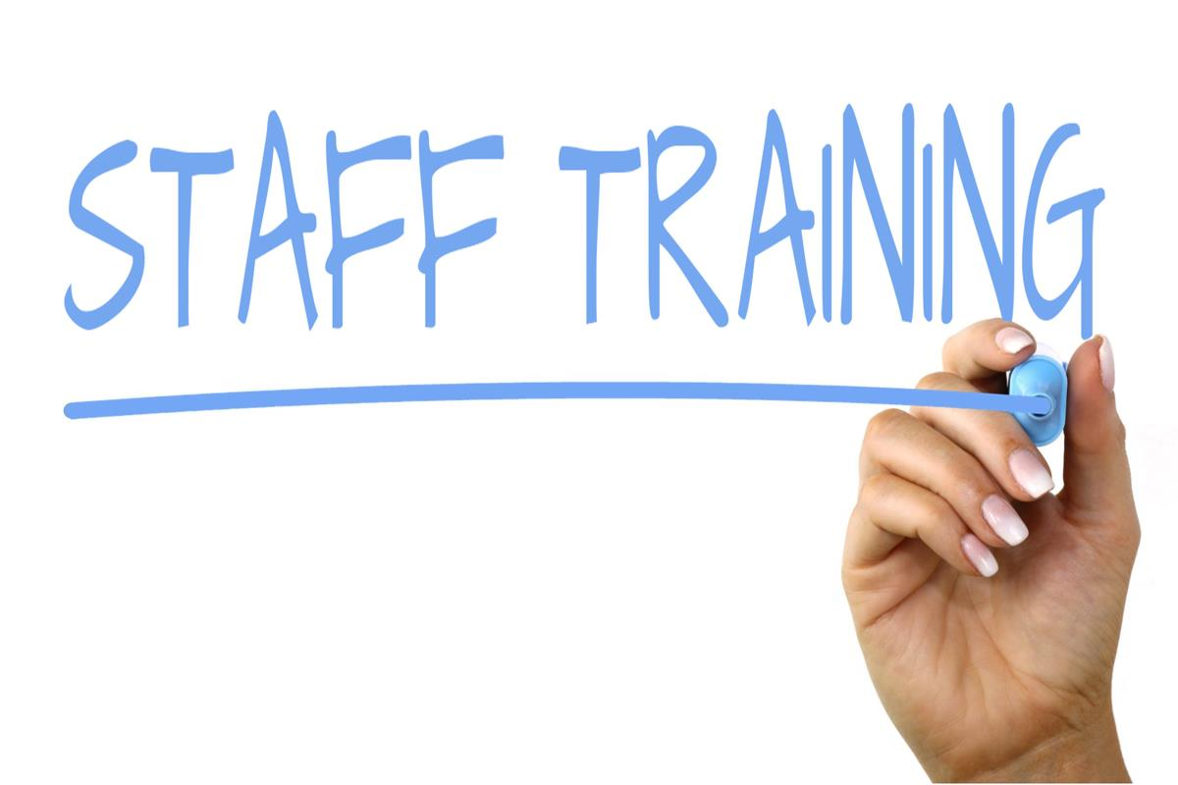
Orientation
Networking
Strategies
Policies
Update
Time management
Find solutions
Share with others
Expand
New aptitudes
New perspective
Re-learn
New Employee
After probationary period
Long standing employee
Notes:
To begin making a plan for your professional development, for Montana State Libraries, you will want to consider whether you are on track for certification or recertification and determine what needs you have to fulfill for those requirements. Everyone should also consider your place in the time continuum of employment.
If you are a new employee or new to your organization or your specific position, you will be in an orientation phase and need to concentrate on some “getting familiar” trainings. Whether your organization has a formal onboarding process or not, you SHOULD seek networking opportunities – Get to know your colleagues, supervisors, administrators, advocates (even your Board and local City government staff). You will want to learn all the specific strategies that others have practiced for success and, of course, policy/manuals/mission/vision/strategic directions. If you are a responsible for the onboarding of others, keep these orientation needs in mind for your incoming staff and be sure to offer help in creating a good experience for them. Does everyone love mandatory training? You know they don’t. You should be an advocate for it and think about helping to make those trainings inviting to others.
If you are comfortably beyond the onboarding, or if you have timed out of the probationary period for your organization, you should move to acquiring new tools in order to reach an advanced level in your performance. Along with continual organizational updates you need to discover technology updates and seek knowledge of updated processes and resources in your field or your specific position within the organization. This is a great time to consider a personal need for best practices of all that you now know. I am talking about time management. There is a multitude of help for all types of time management skills that could help you manage your calendar, calls, task list, site visits, etc.; If you are managing the work of others you can find help to build time management for projects, staff evaluations, conflict mediation, fund raising, program additions and many other facets of your work. Again, does everyone seek or even take advantage of ongoing training? No! So help them to see the need and find the resources.
As the new or less veteran employee are likely to see strains on efficiency that others may be ignoring or oblivious to. This statement is not meant as any kind of malice toward long standing staff but respectfully notes that any of us may be mired in less successful practices under the auspices of “business as usual”. You may be in an advantageous situation that allows you to discover solutions to problems that the organization or your supervisor never thought to move forward on. You might find resources and training to take advantage of opportunities to perform better, faster, or more efficiently and then discuss and propose solutions. This is the time to take advantage of working with long standing colleagues that are performing successfully in their role and share with them what each of you know, understand and do.
As a long-standing employee your toughest job regarding training is to prevent denial that you need training. You need to be aware of this pitfall. For those you supervise, you may serve as a model and expert. It is the perfect time for you to consider training others. Most teachers will tell you that they learn more from teaching others and training others AND this serves as professional development for the trainer! Whether training others or not, willingness to expand your knowledge will naturally help you do things better or do something new. Look for opportunities that bring new aptitudes. My best example: look at the need for virtual meetings and learning right now cause by the onset of the pandemic and the need for social distancing. Don’t we all wish that we had moved faster on learning how to do programs, meetings and teaching with Zoom, Webex, etc. It is not going away. We need to view it as a mainstay and learn to make it something that is comfortable in our work and in our lives. Look for opportunities to discover new perspectives and don’t fall into the mistake of always seeking confirmation of your own beliefs. Branch out to see and empathize with other viewpoints. Your search for resources for training may include experiences such as conferences, retreats, formal course instruction or simply traveling to other libraries to see what their challenges and solutions are to their problems. Or request a short-term relocation to explore different patron-based issues from diverse communities. Consider reading and research as professional development, make it part of your plan, share your findings with others and be sure to document the experience and what you learned.
Each of these experiences will serve to put new energy into your work.
As a teacher/trainer myself, I have found that there is always something to gain from revisiting what you already know so that you can question yourself regarding best practices, learn not to skip necessary steps, or sometimes take the time to un-learn or step backwards and start again.
Training should match your needs according to your place on the time continuum for your work as well as any mandated needs and goal-oriented purposes. If you are managing the training of others, keep this in mind when you are directing them and help them find options that fit their place and work.

Slide 4
A work plan can drive your Goal-Oriented training
What is your work plan?
SMART goals
Specific
Measureable
Attainable
Relevant
Time-bound
Notes:
With all that said, I want to lead you in the right direction for training. I want to help you make personal plans for your Professional Development beginning with a Work Plan. If you have not done a work plan, you will find that it allows you to think through what’s expected of you by others, and what you expect of yourself, your agency, and your work. (click on link to work plan document for briefing through the discussion of SMART goal development) To begin with, look back at your job description, classification designations, and/or past evaluations. Wherever you are on the career time continuum (new employee, past probation, or long-time employee) you will want to have a list of your job responsibilities and an overview of the accomplishments thus far for the year, quarter, interim. Have your organization’s strategic plan available and/or priorities from your City/County priorities. With all that documentation in front of you, you will have a lot to think about and drive you toward targeted professional goals.
Come back to this slide and discuss SMART -
I suggest that you follow the SMART goal setting strategy. If you goals are not easy for everyone to understand you may have a hard time working with them.
SMART goals
Specific – perhaps per department or related focus areas
Measurable – state the goal in terms of outcomes that can be seen, quantified or evaluated on their own
Attainable – make certain that the goal is something the YOU can do. If it calls on others you may want your goal to be management and oversight of those needed to help accomplish the goal rather than the task itself. As part of your plan, include the needed work of others (who are they and what are their responsibilities)
Relevant – The goals should follow logically from the work that you do and the strategic directions of the organization. Caveat: Sometimes your training interests may fall outside the realm of your job description and area of focus, be careful to keep your work plan in line with your work. Training as a goal in your work plan may very well allow for more personal goals (examples – communication, leadership, civility are relevant to management; glassblowing, oil painting may be relevant to programming)
Time-bound – now you need to be able to put the goal on a calendar for when it begins, how you will work through it and when it should end.
Let’s take a look at a sample work plan structure again for the goal development. Note the highlighted portion of my stated goal as example. It uses the SMART strategy which answers the need for specificity and relevance. The un-highlighted portion speaks to the measure and timing. Based on my objective below the goal, you may see that the goal is attainable. I should be able to deliver “effective, efficient and economically sound controls for the provision of professional development”. You may choose to do something less formal, but you will want to consider all of the areas of concern here. It’s pretty straight forward and should serve to inform your needs and be something that you can readily refer to.
Then we move to the action schedule which really informs me about how I will achieve what is needed, what all the moving parts are and who is responsible for each. Again you can see specificity and calendarized tasks. I have highlighted in blue the goals that actually involve training for me and because I am a training administrator, I have shadowed in gray what training is necessary for others. But now I have my training goals!
Before I leave the work plan document – note that you should have an evaluative portion, so you force yourself to think about the successes and failures along the way, list follow-up or feedback activities or opportunities (especially if this has more that one part to its completion). Upon completion you should be able to state the outcome (good/bad/or otherwise). Remember that there is just as much to learn about less successful ventures as there are complete successes AND this will give you a jumping off place for a new phase of the same goal, or a place to build from.
As I said, your plan may not be this formal, but everyone needs to have their thoughts together about their work which the whole work plan will help you put out in detail and that plan will help you assess what training is needed. If you supervise others, help them get to this point as well.

Slide 5
D
I
S
C
U
S
S
Supervisor, Administrator, Manager
Make proposals, find funding
Approve dates/times/locations/delivery
Staff
Notes:
While working on your work plan and training goals, you will want to discuss your intentions with your supervisor, administrator or manager and seek approval. While advocating for your training to meet the plan, advocate for funding and/or suggestions. Be prepared to edit your goals and plan in order to meet what your leadership agrees to and will help with. Remember the Attainable part of the SMART plan? – if your boss wants you to go in a certain direction that differs from your plan or can’t help to finance classes/conferences/etc., negotiate and or adapt your plan. Remember the Relevant part of the SMART plan? The discussion is important for you and for your boss to make your plan fit the needs of the organization or agency.
If you manage others, or others are part of your plan, be sure to discuss everyone’s responsibilities with that staff to advocate collaboration and integration that will merge their plans and your goals before you bring it forward to leadership. Departments that plan together feel ownership and will help each other to achieve greater success. It will be more difficult once you engage others to keep the goal time-bound but once you work out dates/times/locations and delivery of training remember to remain adaptable as that is essential for success.–
Note that what I advocate is that you keep all vested parties accountable for their part in your goal achievement. This will help make the goal attainable and it will help to build better working relationships.

Slide 6
Be aware of storms
Discover new needs
Logistics
Changes
Your goals and your work plan need to be adaptable
Notes:
That said, keep your work plan and your goals adaptable. As I said earlier, be prepared to edit your goals and plan in order to meet what your leadership agrees to and will help with.
You know that things change all the time and not revisiting your plan or blindly moving forward with your training may be counter productive. Your work plan is there to help you meet your goals and your training is directed to help you get there.
Be aware of upcoming events/trainings and keep your eye on the logistics as the day/time approaches.
There may be changes in your job, the organization, your community or the world (even the news of the day) that force you to take a few things off your list or add to it (ex. Staff changes due to Covid. Some of you may have been displaced recently and some of you may be executing the work of those that have been displaced which necessitates training (which may be virtual), but in both cases, it has caused a need for learning new responsibilities). Or there may be a need to discover new goals to replace some that have become more important (ex. Covid response training, safety for patrons/staff, etc).
Through these times, the more proactive and successful organizations are keeping up with the new information, the changes and the needs of their current and future staff as well as the new needs of their customers.
When change is needed update your boss and those involved in the goal’s success (Note: your work plan helped you organize who needs to know of any change). As a matter of fact…

Slide 7
D
I
S
C
U
S
S
Supervisor, Administrator, Manager
Make proposals, find funding
Approve dates/times/locations/delivery
Network
Find opportunities
Staff
Notes:
It bears repeating that once you have a strategy from your work plan that will illuminate your training goals, discuss your intentions with your supervisor, administrator or manager and seek approval.
Your supervisor will need to know, any colleagues affected by or joining in on the training process will need to know your plan.
Remember that you may need to advocate for your training funding and/or suggestions from others for a perfect fit.
You should benefit from suggestions about finding training opportunities within your network such that you may be led to outside networks.
Keep all vested parties accountable for their part in your goal achievement. This will help make the goal attainable and it will help to build better working relationships.
Where can you find training options? Beyond the wonderful options available to you from the Montana State Library Pathway program, don’t be afraid to research opportunities through your local government training offerings, and your organization’s training department. Look to professional organizations and the people, schools and vendors that offer training. Your supervisor may be able to help you but remember to help yourself.
Make that intentional decision to seek training specific to your goals and interests, your team’s goals and your organization’s direction.

Slide 8
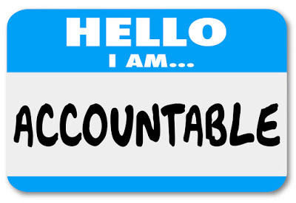
Documentation
Professional Development | YOUR NAME
Training Title: | Speaker/Trainer Name: Speaker/Trainer contact:
Date/Time begun: | Date/Time ended:
Matching Goal:
Review of training:
Proposed follow-up if appropriate:
Notes:
I have stressed that documenting your goals helps to make them real to you and helps you be accountable. You also need to document your training once completed. You should share what you have learned, note its value or lack of, learn what you want to move forward to and record your thoughts for future needs or directions. Any process for this documentation will work (a simple spreadsheet, a file of certificates, or a confirmation on your calendar) but you should make yourself responsible for your own training and the ability to recall what your training accomplished. Don’t allow the time taken to diminish because you want training to always be value added.
I suggest that you keep this documentation as formal as you can manage easily to make it usefully informative to you. If you train others or supervise others, encourage documentation for accountability and to record organizational or departmental compliance with mandatory training as well as give you information for performance evaluations.
Show Niche Academy example (linked):
I have created (with the LMS that I purchased for my goal) an activity that will allow my staff to record training that they have participated in that is outside ofd our Learning Management Software by using the LMS. It makes sense to have a single place to maintain records that the staff and their managers can refer to for compliance and for evaluative purposes.
No matter the procedure or recording tool, it should include:
The training title, the speaker/trainer, date/time/length of time, the goal you are meeting and a short review of the training.
The review is an opportunity to make the training more meaningful and the speaker or trainer’s information will allow you to follow-up or network for further training (or remind you of those you prefer not to attend again, equally as important).

Slide 9
Personal Planning for Professional Development
Create a work plan
Personalize your training to meet your professional goals from your plan
Revisit your plans often for review, assessment and adaptation
Share your goals and plans
Document your training
Be accountable
Elizabeth D. Woodard
EdTalks9@gmail.com
Success Happens when yOUr Learning is Designed for it.
Notes:
You have heard me say what you SHOULD do a lot in this presentation because I believe that Success happens when your learning is designed for it (as per the ‘red’ letters in my statement at the end of this screen. Don’t hesitate to contact me by gmail listed here. I would love to hear from you of you challenges and begin a discussion for solutions. The sample goal and documentation examples are suggestions but I hope that you will consider how important and helpful these plans and documents are to make Professional Development easier to manage and make it meaningful so that you get the most out of it.
To summarize:
Create a work plan
Personalize your training to meet your professional goals from your plan
Revisit your plans throughout the year for review, assessment and to adapt where needed
Share your goals and plans with all vested parties
Document your training and be accountable
Thank you for spending some of your time with me. I wish you well and I wish you great success.
If we have time for questions…..

